Slide 1

EMS-01 Network-on-Chip Design Synthesis Framework
Morphing Machines

Slide 2
Project Key Features
Design and implement various hardware modules for the NoC design component library.
Design and implement the NoC synthesis environment that supports high level functional simulation, Verilog generation, simulation (through a hook to an external Verilog simulator), optimization, etc.
Design and implement the XNOC IDE based upon the Eclipse IDE framework. It must provide comprehensive multi-tab features for visual and programmatic design of NoCs of various classes.
Test, validate, optimize, and measure performance of the implementation.

Slide 3
Project Tasks
XNOC Backend Tool
  Parses the user-defined configuration
  Searches through the library and finds the cells required to create the user-defined NoC.
  Generates the parameters in the appropriate format to customize the hardware library cells for the created design.
  Connects up the selected library cells in the appropriate manner.
  Outputs the resulting NoC in a standard HDL like Verilog.
  Performs error-checking on the resulting NoC HDL to identify any inconsistencies.
XNOC Frontend GUI Framework
  Eclipse-based IDE frontend, with all XNOC specific customizations
  Probable support for a graph editor, for describing irregular network topologies.

Slide 4
Team Members
1. | Aditi Jain | NIT Raipur | XNOC Backend Tool
2. | Arnav Goel | BITS Pilani, Goa | XNOC Backend Tool
3. | Asmita Negi | IIT Patna | XNOC Backend Tool
4. | Dhananjay Dewangan | NIT Raipur | XNOC Backend Tool
5. | Dinesh Sahu | NIT Raipur | XNOC Backend Tool
6. | Jayant Bedwal | MNIT Jaipur | XNOC Backend Tool
7. | Spandana Potineni | IIT Patna | XNOC Backend Tool
8. | Sunil Kumar | NIT Durgapur | XNOC Frontend GUI

Slide 5
XNOC Frontend GUI Framework

Slide 6
XNOC Frontend GUI Stages
The project was divided into following stages:
STAGE – I
  Get the user input and export it into system readable(XML) format
STAGE – II
  Generate regular graphs and let user draw graph.
STAGE – III
  Combine the GUI with the library.
The frontend of the NoC architecture is implemented on
the Eclipse IDE framework to develop a Plug-in of type
Multi Page Wizard & Editor. This allows each user to input
settings for the NoC he/she desires.

Slide 7
STAGE - I

Slide 8
STAGE 1
Creates a four page wizard to allow the user the flexibility for choosing the required Switching, Arbitration, Routing and Flow Control Mechanisms.
It also provides the freedom to the user to parameterize elements related to each flit/packet as per the previous settings

Slide 9
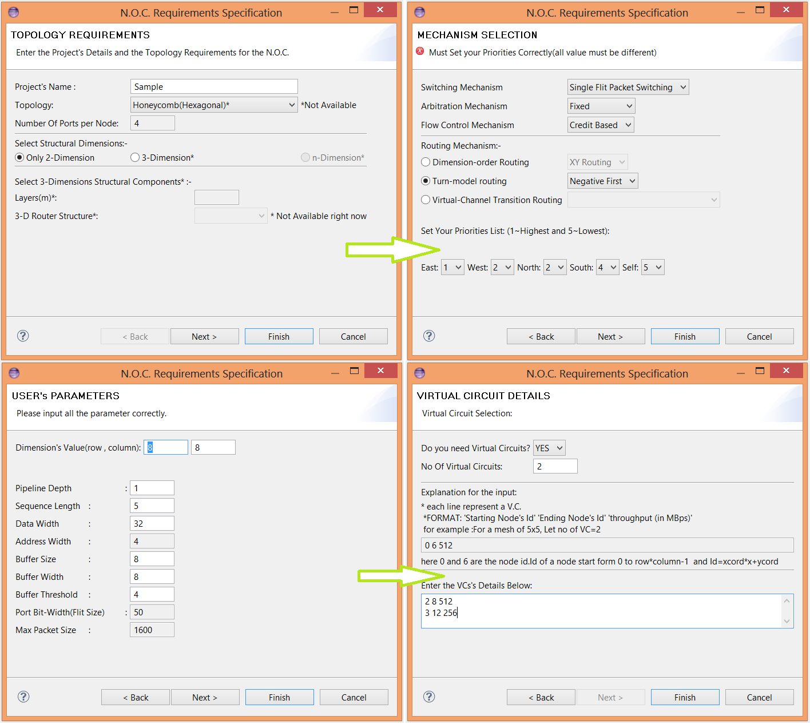

Slide 10
STAGE - II

Slide 11
STAGE 2
Stage 2 of the plug-in makes use of the Open Source Project named Graphiti to allow the user to view regular and build custom topologies of the NoC.
If regular topology is selected, an auto generated graph for the select NoC is displayed else the tool provides freedom to the user to make an irregular topology as per his needs.

Slide 12
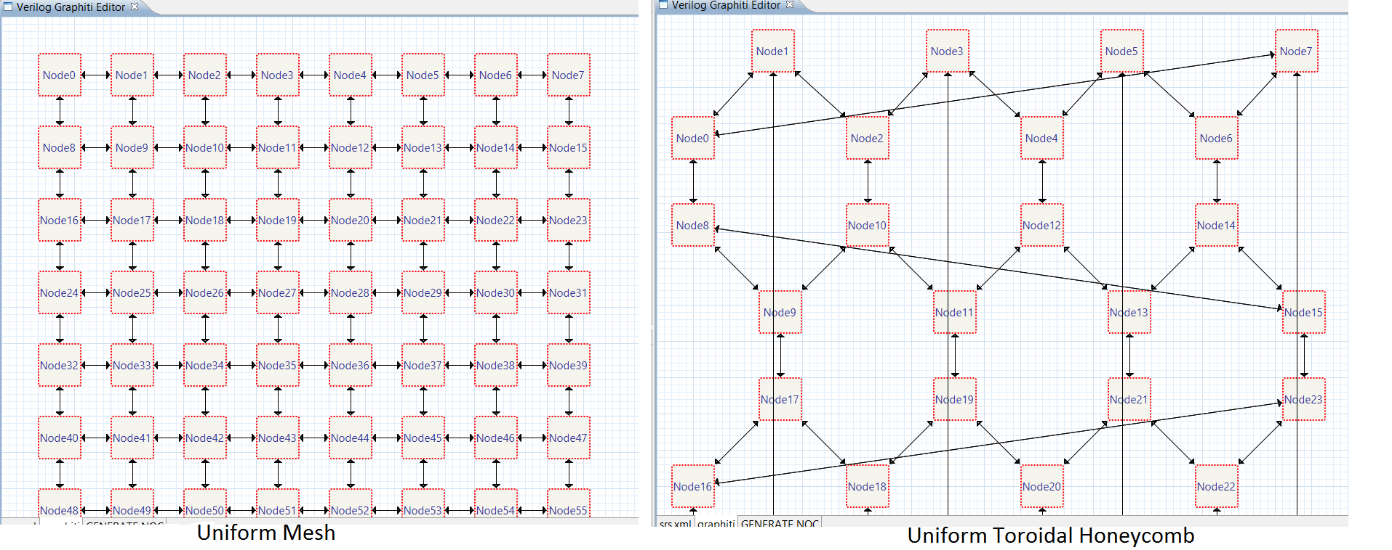

Slide 13
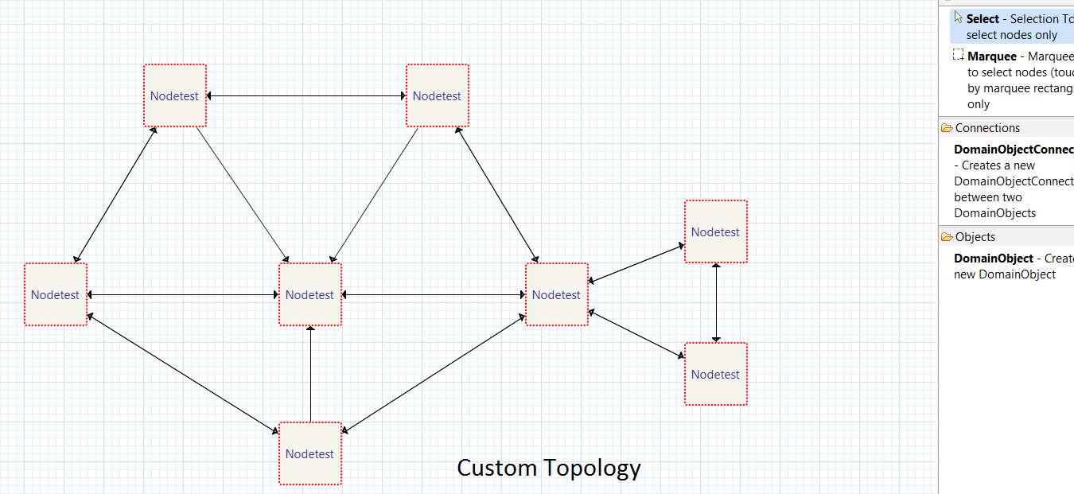

Slide 14
STAGE - III

Slide 15
STAGE 3
Stage 3 of the plug-in provides a comprehensive amalgamation of the configuration settings and graph based topology of the network.
To complete the generation of the required RTL synthesizable files, the 3rd page provides a Generate NoC button which is linked to the NoC backend generator scripts written in Python to dynamically generate the required files.

Slide 16
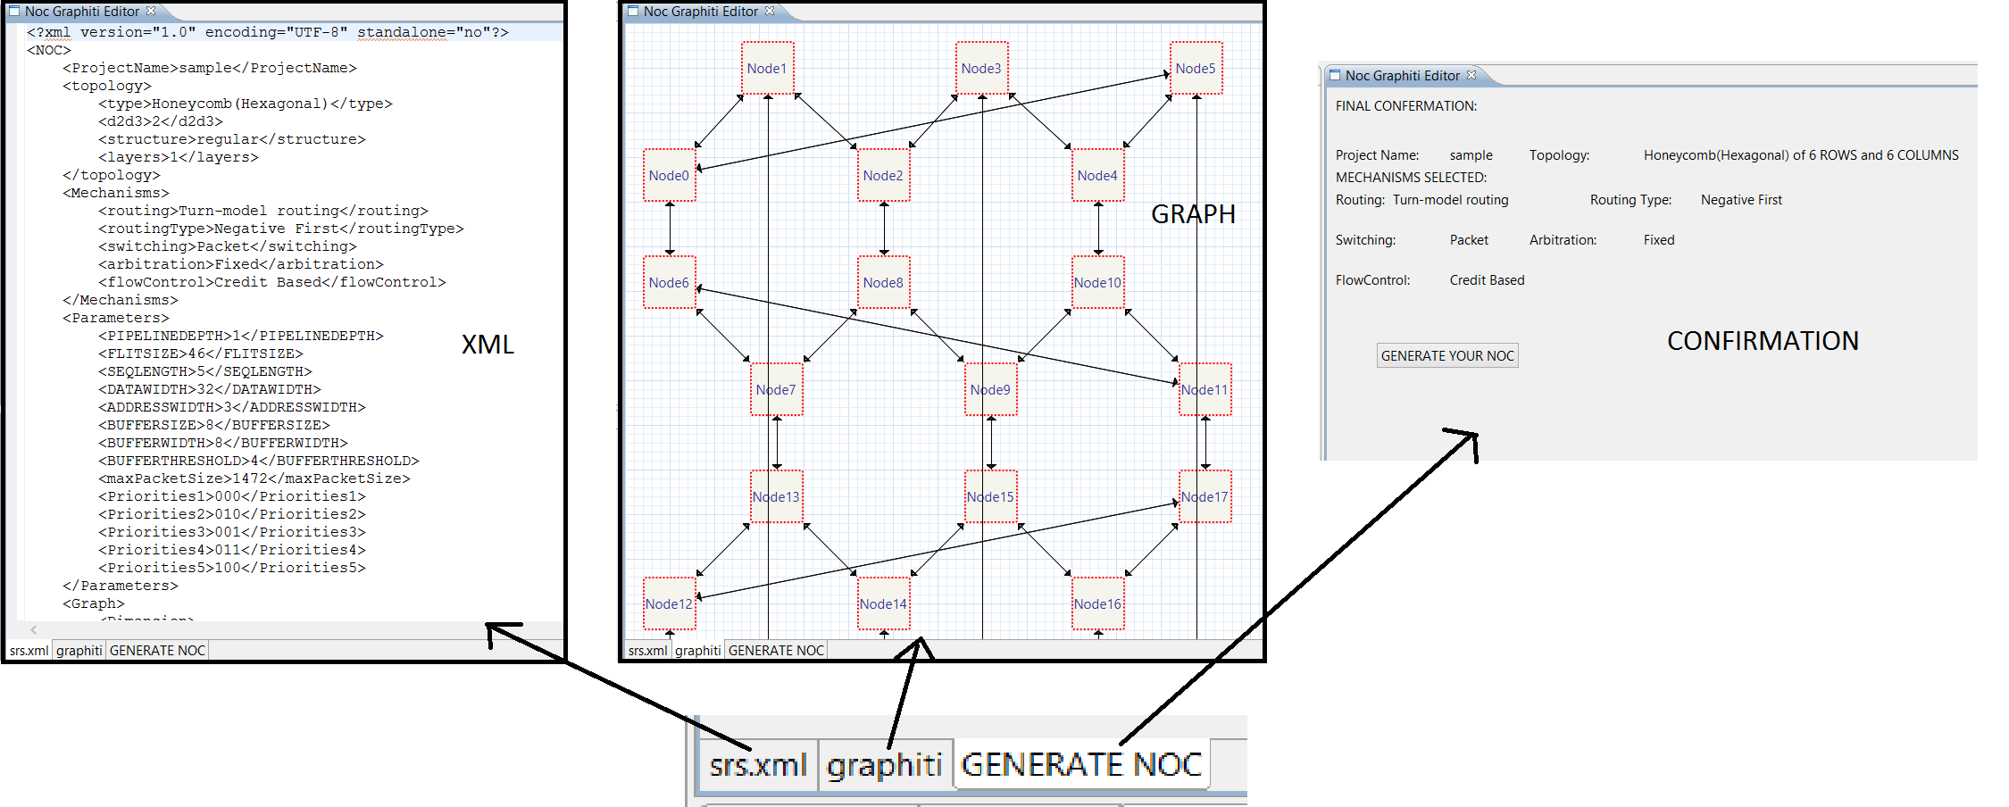

Slide 17
USER INPUT
Library
GUI
BackEnd
NoC
Testing
NoC +TestResults

Slide 18
XNOC Backend Tool

Slide 19
XNOC Backend Tool Stages
The whole project task of preparing a XNOC Backend Tool in Verilog was divided into three stages
STAGE - I
  Writing Individual Modules for Buffer, Flow Control , Routing , Switching and Arbitration Mechanisms.
STAGE – II
  Designing the top level mesh network and making the interconnections of all the modules.
STAGE - III
  In this stage, local port of each router was connected to a stub, flits were injected into the network and testing was done.

Slide 20
STAGE - I

Slide 21
Modules Implemented
Buffer(FIFO)
  With and without the implementation of Virtual Channels
Flow Control Mechanisms
  Go & Stop
  Credit Based
Routing Mechanisms
  Dimension Order
    XY Routing
    YX Routing
  Turn Model
    West First Routing
    North Last Routing
    Negative First Routing
  Virtual Channel Transition
    Balanced Dimension Order
Arbitration Mechanisms
  Fixed Arbitration
  Round Robin Arbitration
  Least Recently Used(LRU)
  Weighted Round Robin(only for Circuit Switching)
Switching Mechanisms
  Packet Switching
  Circuit Switching

Slide 22

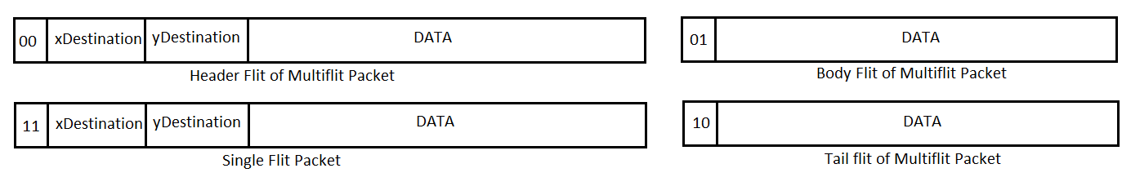
Flit Format
Packet Switching
Circuit Switching

Slide 23
BUFFER

Slide 24
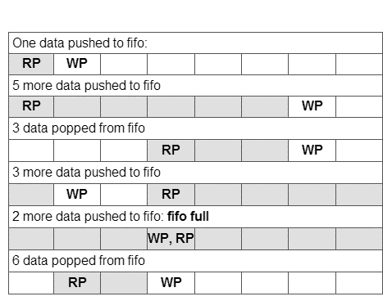
Buffer Mechanism
The buffer module has been realised as a FIFO memory.
Two pointers readPointer and writePointer, point to the read and write locations in the memory.
Whenever the enq signal is present, the data on the input port is written into the buffer, and writePointer is incremented.
Always the data location pointed by the readPointer appears on the buffer output.
Whenever a deq signal is received, the readPointer is incremented to pint to the next data location.
The isValid signal from the buffer decides whether the data on output port of buffer is valid or not.
If readPointer and writePointer are same location, then buffer is empty.
If the difference between the two is equal to buffer size then this indicates that the buffer is full.

Slide 25
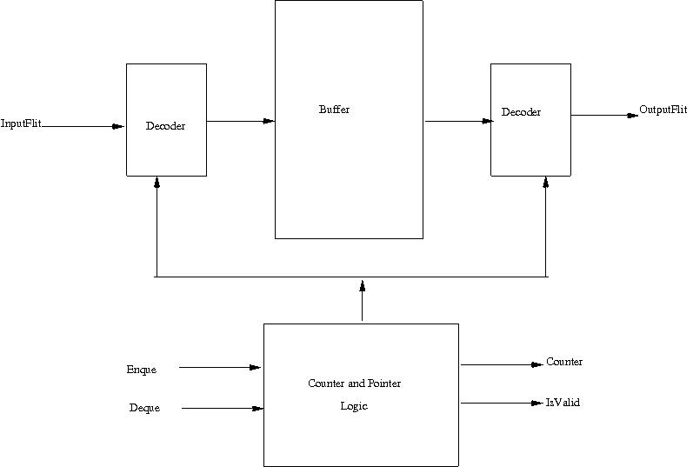
Buffer

Slide 26
Buffer(With VC)
The buffer implementation in case of a VC, includes as many buffers as the number of virtual channels available.
The buffer also has an additional signal ENC, coming from the routing team of the previous router, specifying the Virtual Channel to be employed to send the flit.
According to ENC signal, the incoming flit is stored in the corresponding buffer marked by that ENC value.
If we have two Virtual Channel, then ENC can be 0 or 1 marking the two VCs available. The flit will be stored in Buffer0 or Buffer1 according to the ENC value specified by Routing Mechanism.

Slide 27
FLOW CONTROL MECHANISM

Slide 28
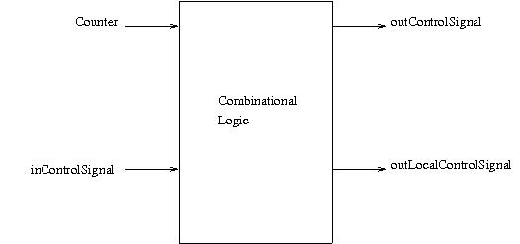
Flow Control Mechanism

Slide 29
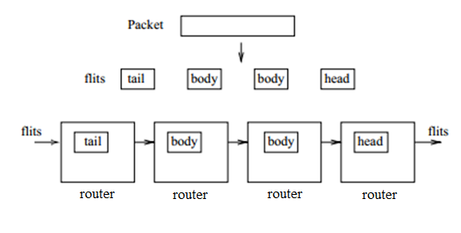
Wormhole Switching
Wormhole switching allocates buffers and physical channels to flits instead of packets.
A ﬂit, the smallest unit on which ﬂow control is performed, can advance once buffering in the next switch is available to hold the ﬂit. This results in that the ﬂits of a packet are delivered in a pipeline fashion.
As such for the same amount of storage, it achieves lower latency and greater throughput.

Slide 30
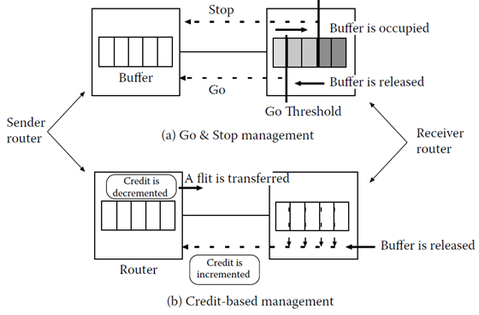
General Mechanism
Flow Control determines how the resources of a network, such as channel bandwidth and buffer capacity are allocated to packets.
Goal is to use resources as efficient as possible to allow a high throughput.
An efficient flow control is a prerequisite to achieve a good network performance.
In buffered flow control nodes there is a need for communication between nodes in order to inform about the availability of buffers.
Backpressure informs upstream nodes that they must stop sending to a downstream node when the buffers of that downstream node are full.

Slide 31
Go & Stop Flow Control
Go & Stop Flow control tries to reduce the amount of upstream signalling.
A Stop signal is sent to the upstream node, if the number of free buffers falls below the threshold.
A Go signal is sent to the upstream node, if the number of free buffers rises above the threshold.
With carefully dimensioned buffers Go & Stop flow control can achieve a very low overhead in form of upstream signalling.

Slide 32
Credit Based Flow Control
The upstream router keeps a count of the number of free flit buffers in each virtual channel downstream.
Each time the upstream router forwards a flit, it decrements the counter.
If a counter reaches zero, the downstream buffer is full and the upstream node cannot send a new flit.
If the downstream node forwards a flit, it frees the associated buffer and sends a credit to the upstream buffer, which increments its counter.

Slide 33
ROUTING
MECHANISM

Slide 34
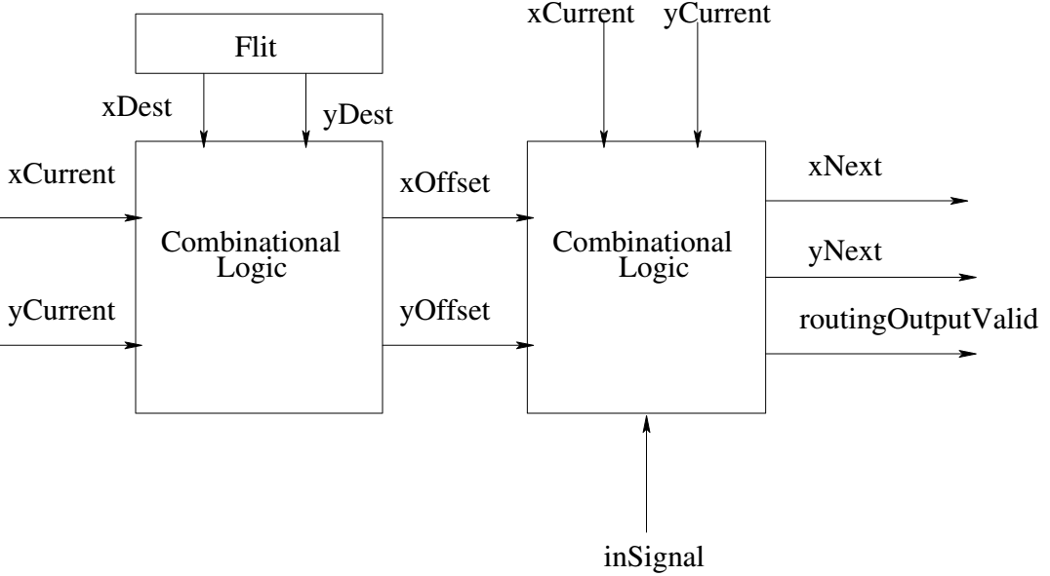
Routing Mechanism

Slide 35
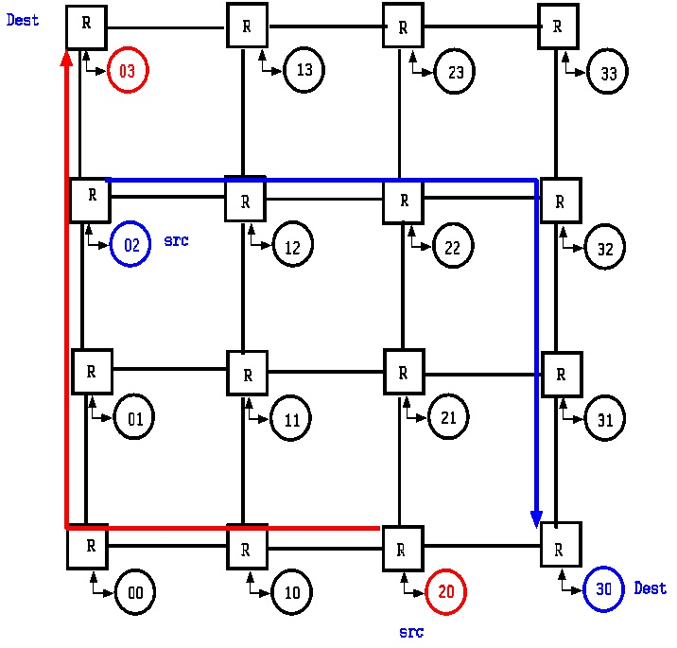
XY Routing
There is a fixed minimal path between source and destination.
The packets must travel the entire distance in X-direction first and then it starts travelling in Y-direction when xOffset becomes zero.

Slide 36
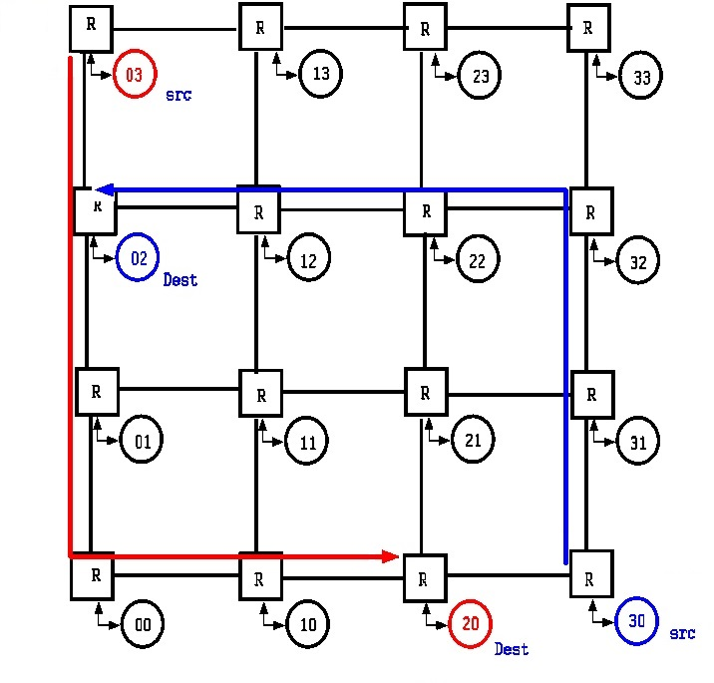
YX Routing
This model is similar to XY-Routing i.e. fixed minimal path but in reverse manner.
The packets must travel the entire distance in Y-direction first and then it starts travelling in X-direction when yOffset becomes zero.

Slide 37
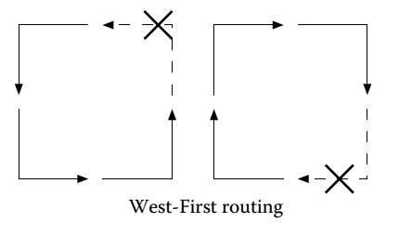
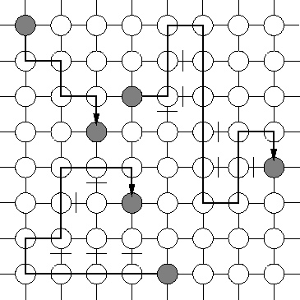
West First Routing
All turns to the west are prohibited, so a packet must start out in that direction in order to travel west. This requirement suggests the west-first routing algorithm: route a packet first west, if necessary, and then adaptively south, east, and north.
Adaptive routing

Slide 38
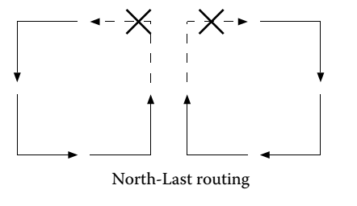
North Last Routing
The entire distance that has to be travelled in the north direction, the packets would travel at last after the condition occurs when yOffset becomes greater than zero and also xOffset equal to zero.
Ten turn from north to any other direction is prohibited.

Slide 39
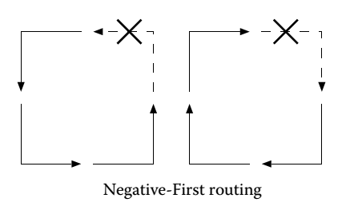
Negative First Routing
This model restricts turns in two directions i.e. north to west and east to south.
Route a packet first adaptively west and south, and then adaptively east and north.

Slide 40
Balanced Dimension Order Routing
Depending on the destination, each packet is injected into a particular virtual channel, where it is routed until it arrives at its destination.
The balanced dimension-order routing (BDOR) forwards packets in one of two routes (XY- or YX-orders), depending on relative position of a source-destination pair which chooses either XY or YX routing, in order to improve the balance of paths.
The ENC signal of router is 0 specifies XY-order and VC 0, whereas the value of ENC signal 1 specifies that YX-order will be followed and VC 1 will be used.

Slide 41
ARBITRATION MECHANISM

Slide 42
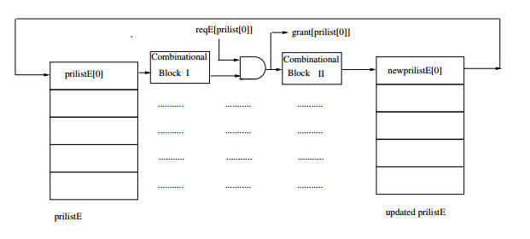
Arbitration Mechanism

Slide 43
General Mechanism
Arbiters are used when more than one packet from different port wishes to go to the same destination.
A priority list a register that has the current priority list.
Combinational block I and request determines the grant.
Grant is issued to a port only if ports above it in the current priority list do not raise request for same destination.
Combinational block II update the priority list based on the grant issued and algorithm implemented.

Slide 44
Fixed Arbitration
Priority list is taken as an input from user.
Ports ranked lower in priority list are not served until the ports ranked higher have been served
Priority list remain same.
It has the advantage of simple implementation & small area and cost.
In heavy communication traffic port with lower priority does not get a grant signal and may suffer starvation.

Slide 45
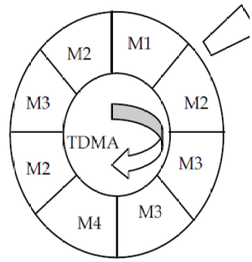
Round Robin Arbitration
Divides execution time on bus to time slots.
Each slot is statically reserved for a unique port. In case of no request during its time slot the timing wheel is rotated by one slot until a request is encountered.
The advantage is that no port suffers starvation.

Slide 46
Least Recently Used(LRU) Arbitration
The priority list gets updated after each allocation.
Port served least recently gets the highest priority.
The advantage is that none of the port suffer starvation.
The implementation is complex than fixed static algorithm.

Slide 47
Weighted Round Robin Arbitration
Aids to slot allocation for circuit switching.
Few clock cycle are statically allocated for a particular port irrespective of the request.
Slots allocated only to the ports that request for the shared buffer.

Slide 48
SWITCHING MECHANISM

Slide 49
Switching Mechanism
Basic Implementation
Diagram of Implementation labelling all the I/O

Slide 50
General Mechanism
The switching mechanism is implemented using a multiplexed crossbar network. The inputs to the each port of the router comprises of an input flit and a flit validation signal from the flow control mechanism followed by a validation signal corresponding to the coordinates computed by the routing mechanism and a grant signal generated on the basis of the direction request logic from the arbitration mechanism.
Each port works in parallel to achieve a crossbar implementation of communication between the native and the immediate neighbouring routers.
Based on the grant signals and the input validation signals from flow control & routing modules, the selection logic to a multiplexed network is enabled to generate the respective En-queue and De-queue signals for each port of the router.
These are accepted as control signals by the buffers present at each port of the immediate neighbouring routers.

Slide 51
Single Flit Packet Switching
For implementing single flit behaviour, each flit carries a unique destination address which is utilized by routing mechanism to compute its immediate next coordinates and are made available as inputs to the switching module. Since 1 packet is equivalent to 1 flit, Wormhole Switching is implemented in our design.

Slide 52
Multi Flit Packet Switching
For implementing multi flit behaviour, a sequence of 3 types of flits primarily known as Header, Body and Tail are utilized.
In the above set sequence, the destination coordinates reside in the Header flit.
As the Header hops across each router of the mesh architecture, it disables a set of signals named allowHeader for each port along its path to which it has hopped from.
This prevents the entry of another Header flit along the same path and makes sure that only Body flits and Tail flits can traverse along the path used by its corresponding Header.

Slide 53
Circuit Switching
For implementing Virtual Circuit behaviour, a set of configuration files are generated per port per router.
These configurations contain a sequence of cycle based allocation for each port of a router to emulate Time Division Multiplexing (TDM) at each node of the mesh architecture.
The allocation takes place in synchronization with the Weighted Round Robin algorithm.

Slide 54
Metaprogram.py Python Script
Parsing across XML (generated by the front-end) to obtain source & destination coordinates and each VC or Virtual Circuit’s throughput in Bits per second is carried out.
The coordinates are used to compute previous and next directions ( considering 2D uniform mesh with 5 ports ) ; Each coordinate along with next coordinate address( via XY or YX routing ) is stored in list of list type data-structure. These are subsequently zipped into two independent dictionaries.
Each dictionary is traversed and the set of conflicting & non-conflicting VC number are distinguished.
  For conflicting VC’s, on the basis of the hop count at each node and their respective admit rates , slot allocation is carried out with maximum admit rate being the differentiating factor between the 2 conflicts.
  For non-conflicting VC’s, slot allocation takes place per port per router as per the analysis of the two dictionaries generated previously.

Slide 55
STAGE - II

Slide 56
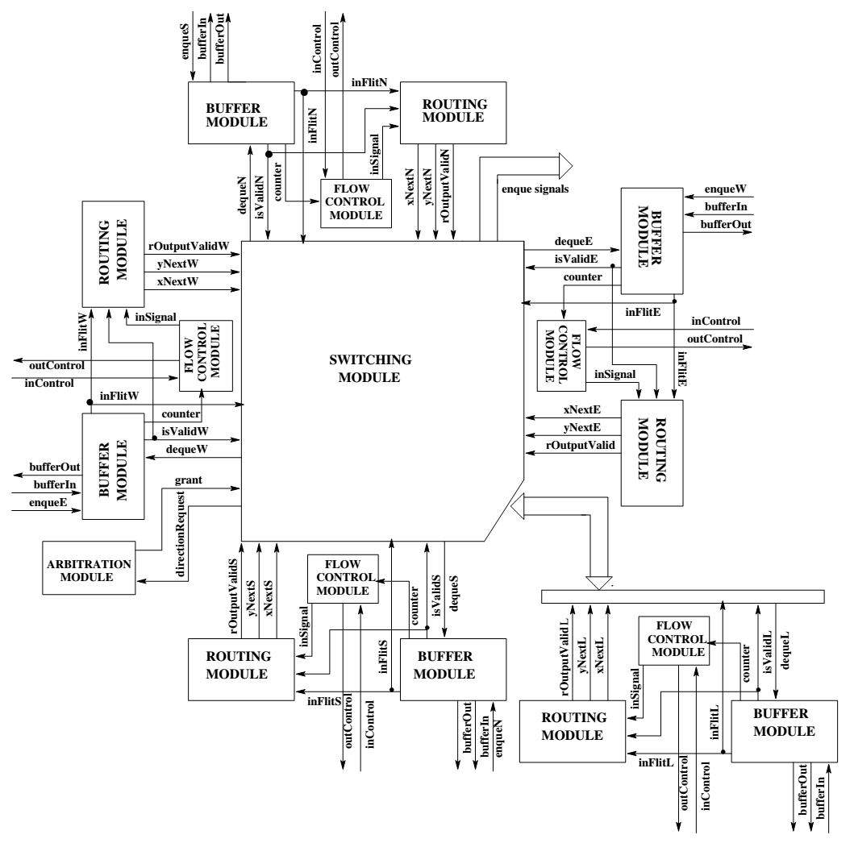
Router

Slide 57
Mesh Network
Diagram

Slide 58
Mesh Network
Initially a simple mesh network was implemented, taking up a single module from each of the teams.
The mesh network was implemented directly in Verilog HDL to finalize the interconnections between different modules.
This was later implemented in a Python Script which now generates these connections into a Verilog file using the xml file generated by the XNOC Frontend GUI which is based on the customizations selected by the user for the NoC.

Slide 59
Mesh Network Python Script
The Mesh Network Python script consists of three python script files:
  router.py
  mesh.py
  testbench.py
The mesh network python script, reads up the NoC customizations from the xml file of the XNOC Frontend GUI.
It then generates four Verilog HDL files for the mesh network:
  router.v
  parameter.v
  mesh.v
  testbench.v

Slide 60
router.py Python Script
  The router.py script file generates two files, after parsing the xml file of XNOC Frontend GUI, on its execution :
    router.v
    parameter.v
  The router.v file contains the instantiation of all the independent modules from each of the teams and the interconnections between these modules.
  The wires between two different router modules are defined as input output of the router module.
  The parameter.v contains the all the parameters in the appropriate format to customize the hardware for the created design.
  The parameter.v file is included in all of the top mesh level files.

Slide 61
mesh.py Python Script
The mesh.py file, generates a single mesh.v Verilog file on its execution which includes the parameter.v file.
The mesh.v file contains the instantiation of the router module as many times as there are nodes in the mesh.
In the instantiation of the router module the coordinates for each of the router are passed as parameters , which are further passed to the different independent modules instantiated inside the router module.
The connections to the local port of each node are defined as the input outputs of the mesh module.

Slide 62
testbench.py Python Script
The testbench.py file, generates a testbench.v Verilog file on execution which includes the parameter.v file.
The testbench.v file contains the instantiation of the mesh module and the stub module.
The stub module is instantiated once for each local port of each node in the mesh.
The stub is attached to the local port of each node and the wire connections for the same are made at this level.

Slide 63
STAGE - III

Slide 64
Testing
Various mesh configurations that can be generated by XNOC IDE were tested.
For testing a Stub is attached at the local port of every router in the mesh.
The Stub generates one flit every clock cycle in a prescribed format as required by various configurations.
These flits are stored at the destination and the source and are matched using a python verification script at end of the simulation.

Slide 65
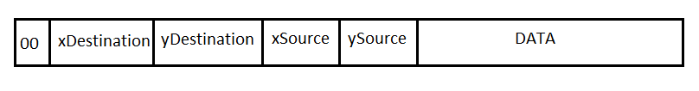
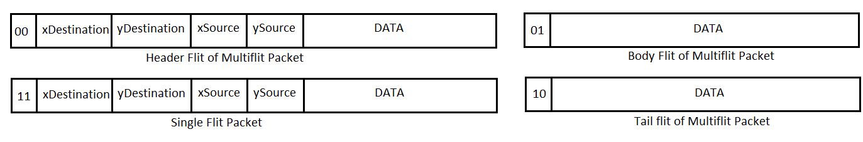
Flit format for Testing
Packet Switching
Circuit Switching

Slide 66
Flit format for Testing
The first two bits of the flit specify whether it is a header(00) , body(01),or tail(10) flit in case of Circuit Switching. For single flit packet the bits are specified to be 11 to differentiate them from other packets. In case of Packet Switching the bits always remain 00, reflecting the fact that each flit is a header flit in itself.
Next bits are the coordinates of the destination. The span of the bits are according to the no of ports in the mesh.
Following the destination, are the coordinates of the source , which are a part of the data which is carried by flits.
The remaining bits for the data part are generated by using random data from files generated by a python script.

Slide 67
Stub
The stub module takes up three string parameters. These are:
  inFlit{xSource,ySource}: These files are generated using a python script and contains random data, which is used to form the data part of the flit.
  sent{xSource,ySource}: Formed at each of the source stub nodes, this file contains all the flits that are injected into the network by the stub.
  rcvd{xDest,yDest}: Formed at each of the final destinations, this file contains all the flits that are successfully received from various sources.
The stub module generate the flits, using the coordinates of the current node and appending it with the randomly generated destination coordinates and data from the files.

Slide 68
Python Verification Script
At end of the simulation, a verification script written in python is executed.
The script generates the coordinates of each of the nodes, in the range given by the xml file, performs some string operations and generates the received flits file name(e.g. rcvd010101) for each node.
Each of the received flit is read from the file, its source coordinates are extracted, sent file name is generated , and the flit is matched.
The result is written into a log file, which can then be either read manually or the final result can be displayed in percentage terms at the end.

Slide 69
Thank you!

